Slide 1

Week 1 Key Concepts
NURS 6075
Chris Macintosh, PhD, RN

Slide 2

Concepts to focus on
The PowerPoints for each week are the topics to focus on closely.
They also may contain additional explanation which may not be covered in the assigned readings or video lectures.

Slide 3
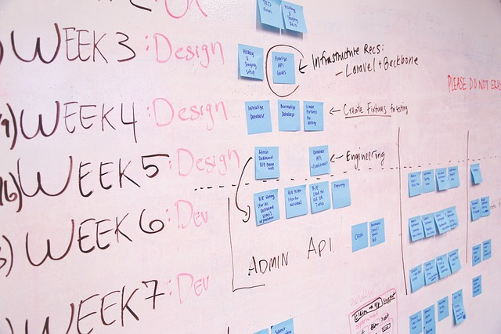
Organization of Text and Class
Andy Field organized his text to highlight the similarities between statistical tests.
This is useful for learning the basic analysis process.
Some of the details may differ between tests, but the steps are usually the same.
I plan to follow his ordering of concepts, but with a few minor deviations
I plan to emphasize the steps for conducting a data analysis a bit more than statistical concepts.

Slide 4

Why Discovering Statistics text?
Of all the statistics texts I have used or read I like this text the most.
Some texts focus on theory with little explanation of how to do an analysis.
Some sources describe the basics of an analysis with little explanation of why they follow the steps they do.
This text provides a nice balance between the two.

Slide 5

Why an SPSS text?
It is the most current version of Field’s text.
The R version of his text is several years old and does not teach the most current data handling practices in R and current statistical trends like Bayesian analyses.
Other R resources either don’t provide sufficient statistical theory explanation or require a mathematics background beyond the level of this course.
Field gives nice examples of how to write up analyses while many other texts don’t.
We’ll use other R resources to learn to do our statistical analyses and read Field for explanation of the statistical tests. (It’s a great reference to keep around if you need a refresher.)

Slide 6

Why use R instead of something else?
R is used widely in healthcare (and many other fields) for data analysis and analytics.
Business Intelligence and analytics tools like Tableau are built on top of R.
You’ll be able to use R after you graduate. (Being familiar with R will give you additional credibility.)
The non-academic versions of most other statistical software are expensive.
Many statistical programs (like SPSS which I learned in school) are moving to yearly subscription models and cost in excess of $1000/year for a non-student license.

Slide 7


Why R for Data Science text?
It provides a nice introduction to data analysis techniques using R.
It introduces a data handling and analysis framework in R called the Tidyverse. https://www.tidyverse.org/
Tidyverse packages standardize a lot of data management and analysis practices.
Tidyverse packages and concepts are gaining wider acceptance.
It would be a serious omission to ignore this developing framework.

Slide 8

Learn to Identify and Describe Variables
Understanding variable types and characteristics is foundational to performing statistical analysis.
Understanding what data will be used for is essential to deciding what to store and how to measure and store it.
An understanding of level of measurement will help you be more competent in practicing informatics.
If you learn one thing this week it should be how to correctly identify the level of measurement of a variable.

Slide 9
Collect data to test your theory
Hypothesis:
Coca-cola kills sperm.
Independent Variable
The proposed cause
A predictor variable
A manipulated variable (in experiments)
Coca-cola in the hypothesis above
Dependent Variable
The proposed effect
An outcome variable
Measured not manipulated (in experiments)
Sperm in the hypothesis above

Slide 10
Levels of measurement
Categorical (entities are divided into distinct categories):
Binary variable: There are only two categories
e.g. dead or alive.
Nominal variable: There are more than two categories
e.g. whether someone is an omnivore, vegetarian, vegan, or fruitarian.
Ordinal variable: The same as a nominal variable but the categories have a logical order
e.g. whether people got a fail, a pass, a merit or a distinction in their exam.
Continuous (entities get a distinct score):
Interval variable: Equal intervals on the variable represent equal differences in the property being measured
e.g. the difference between 6 and 8 is equivalent to the difference between 13 and 15.
Ratio variable: The same as an interval variable, but the ratios of scores on the scale must also make sense
e.g. a score of 16 on an anxiety scale means that the person is, in reality, twice as anxious as someone scoring 8.

Slide 11

Level of Measurement Can’t be Identified by Name Alone!
You can’t identify the level of measurement of a variable by only knowing the name. You need to know what the data actually look like.
Take Income for an example:
Nominal – Source of income. (Job, Stocks, Bonds, Inheritance, etc.)
Ordinal – Yearly income is reported in ranges. ($20,000 - $29,999, $30,000 - $39,000, etc.)
Ratio – Yearly income is reported in specific dollar amount. ($40,000/year, $52,000/year, etc.)
Those could all be named “Income” as variables, but the level of measurement is very different.
Many students miss this point.

Slide 12
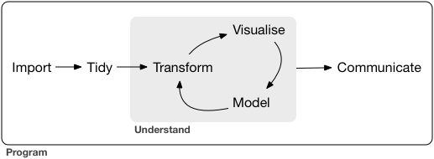
Analysis process will guide in the next step of an analysis

